Slide 1
Active galactic nuclei, gravitational redshifts, and
cosmological tensions
https://arxiv.org/abs/2304.13036

Slide 2
01.
Contextualization and Introduction

Slide 3
\\\
\\\
Redshift:
"Full Redshift":
Composed by Cosmological, Gravitational and Doppler redshifts
Gravitational redshift treated as "noise"
From Modern Cosmology by Scott Dodelson
The redshift is related to the comoving distance of two points in the Universe

Slide 4


Slide 5
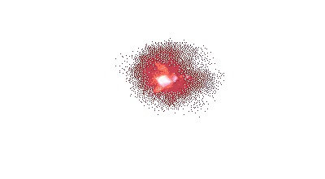

Slide 8
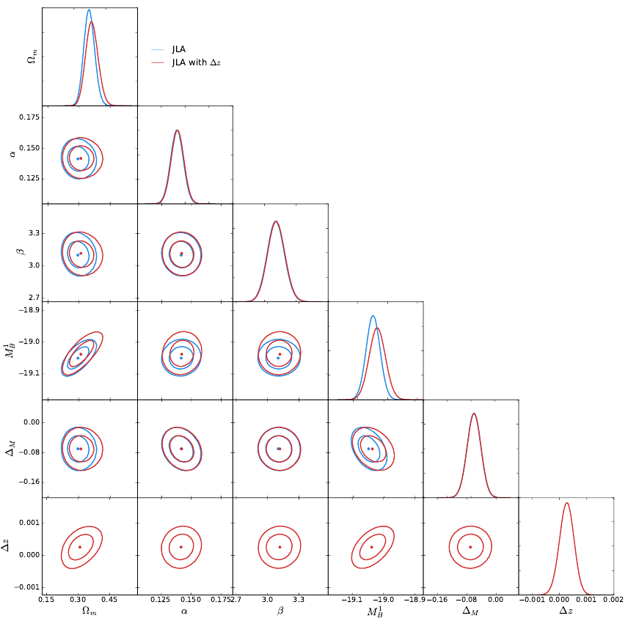
Calcino & Davis (2017):
The found gravitational redshift brings the density matter parameter into agreement with the CMB
Chandrasekhar mass limit:
This paper:
Shows a signature of supermassive black holes (SMBH) gravitational reshift in galaxy lines
https://arxiv.org/abs/1610.07695

Slide 9
02.
Gravitational Redshifts of AGN and Quasars

Slide 10
\\\
Gravitational Redshift:

Slide 11
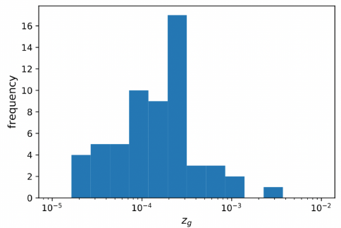
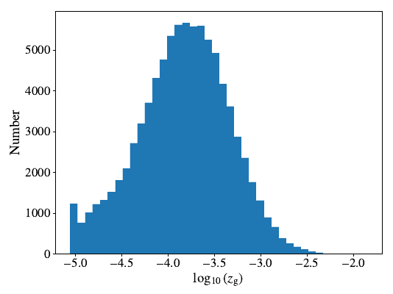

\\\
\\\
AGN Black Hole Mass Database:
DR14 of SDSS (quasars):
Histogram of 75 Seyfert I galaxies
With full width at half maximum (FWHM) measurements of

Slide 12
03.
Redshift excess in nuclei emission lines

Slide 13
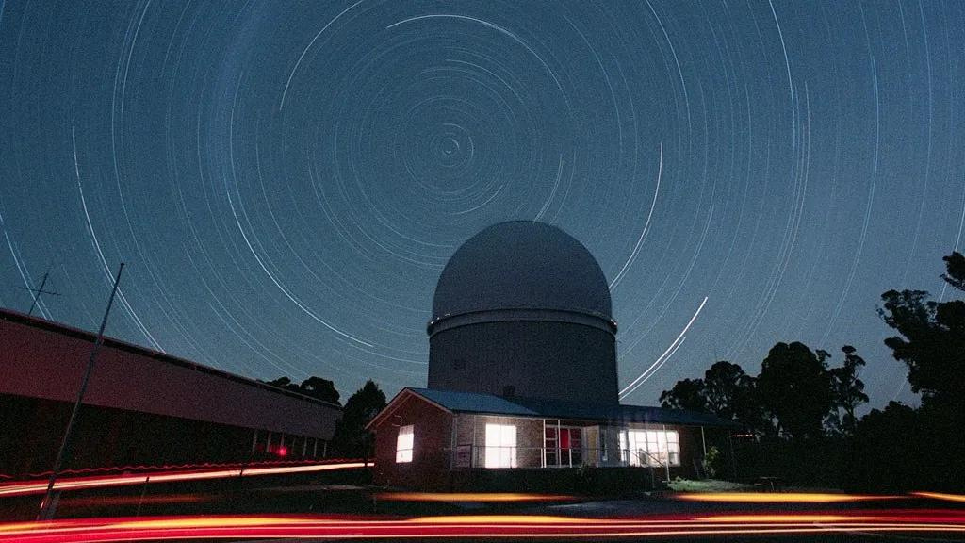
Sydney Australian Astronomical Observatory Multi-Object Integral Field (SAMI):
Compilation of galaxies from the third data release of SAMI
Final sample:
40 galaxies:
9 with clear AGN signatures (8 are LINERs, 1 is Seyfert II)
9 are starbusts (HII)
The rest are composite galaxies (starbust + AGN)
Only LINER galaxies are going to be considered for the AGN sample
https://www.cntraveler.com/activities/millers-point/sydney-observatory

Slide 14


Slide 16
Not conclusive

Slide 17
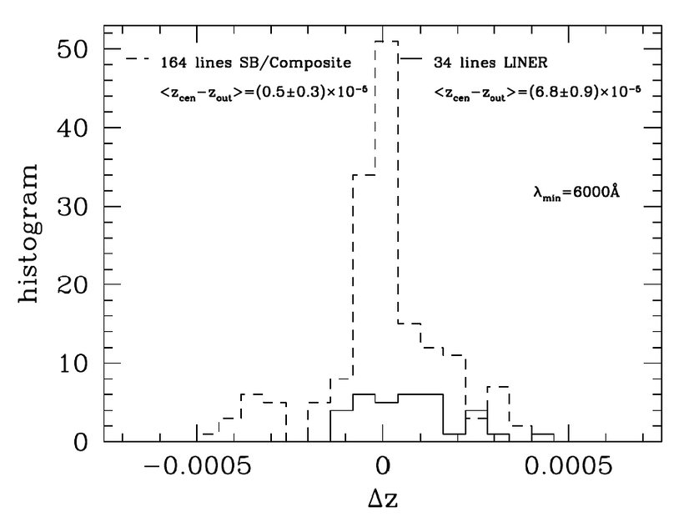

Not conclusive

Slide 18
04.
Concluding remarks

Slide 19
\\\
\\\
Section 2:
Section 3:
AGN Black Hole Mass Database:
Smaller thant those found in Section 2
Possible reason: combination of starbust and AGN galaxies
Star formation can mask AGN as non-AGN (Pastoriza et al. 1999)
Central annuli could be contaminated with blueshifted outflows (Muñoz et al. 2022)
DR14 of SDSS (quasars):

Slide 20
\\\
Relevance:
The Pantheon+ code I implemented on UCLCl uses a redshift of 0.001 < z < 2.3
It could be relevant for z = 0.001
https://arxiv.org/abs/2202.04077

Slide 21
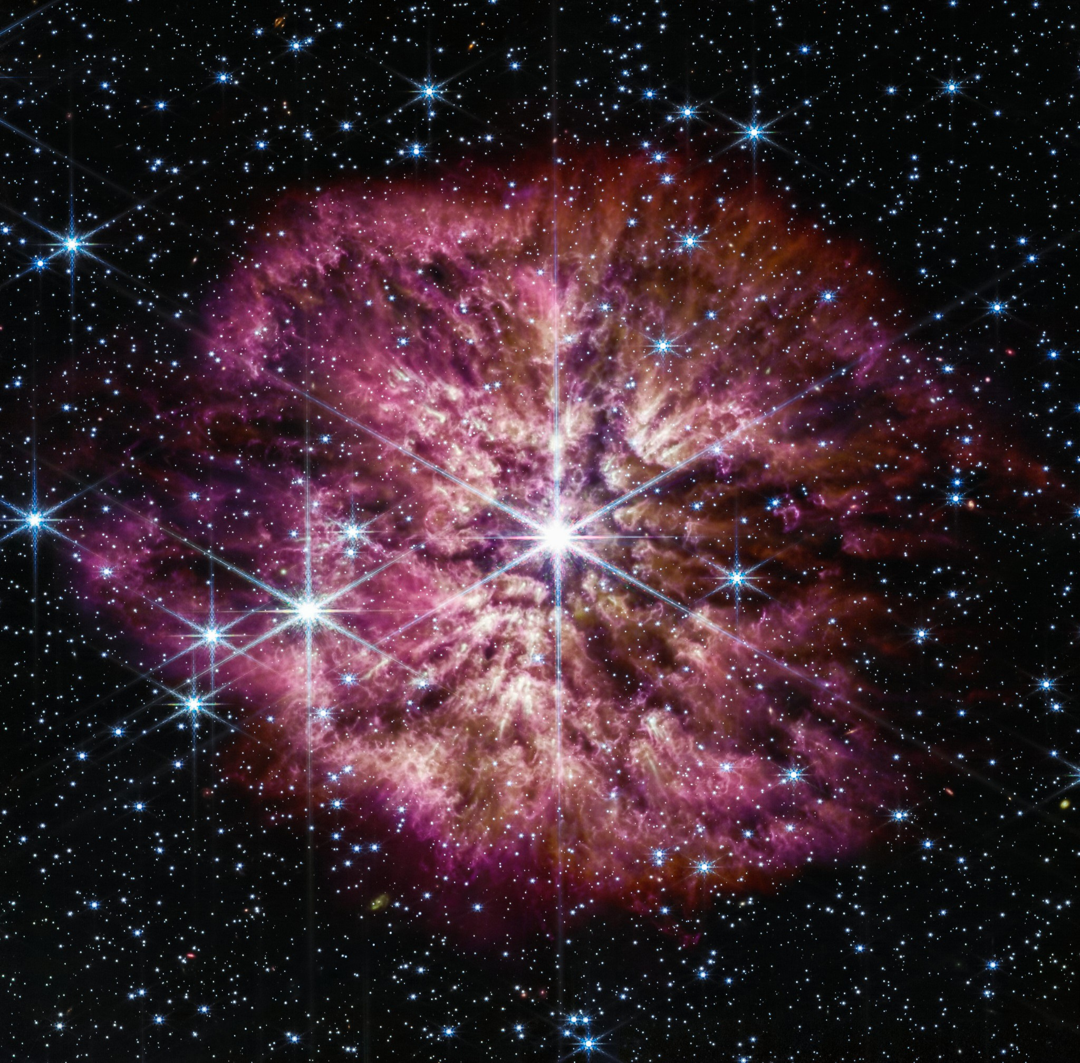
thank you!

